Slide 1

Wireless Networking
Ambuj Varshney
ambujv@nus.edu.sg
Notes:
++ Thank you for inviting me to give this talk
++ In this talk, I will present a pathway that can enable us to make wireless embedded systems ubiquitous. I will describe my previous research efforts that tackle the critical challenges that limit the growth of wireless embedded systems. These are related to the growing energy asymmetry that exists between sensing, computation and communication blocks on these platforms.
++ Finally, I will conclude my talk by covering the research agenda that I would like to work on as a faculty member.

Slide 2
Administrative stuff
Course webpage: Canvas
First tutorial is already uploaded. Anyone without tutorial slot?
Ed: Platform for asking question, team mate. Received notification?
First lecture video is already uploaded on the canvas
Next week tutorial
Missing session? Do on your own, and discuss with TA’s in the coming week
Drop me a message and we can discuss tutorial as well

Slide 3
Roadmap of the lecture today
Quick Recap
Antenna Continued
Line of Sight and Non Line of Sight
Modulation Basics

Slide 4
Quick Recap
Notes:
++ Over the past few years, I have designed several backscatter and beyond backscatter systems that precisely overcome these critical challenges that have limited the widespread deployment of backscatter on IoT devices.
++ The research vision that I have pursued and would like to pursue as a faculty member is to enable a massive deployment of IoT devices by bridging the energy asymmetry between sensing, computation and communication blocks by designing novel platforms and communication mechanisms. I am going to describe some of my research contributions next.

Slide 5
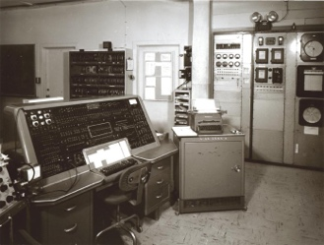
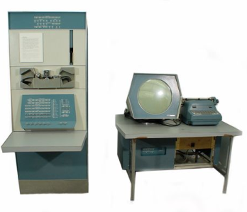
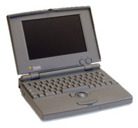
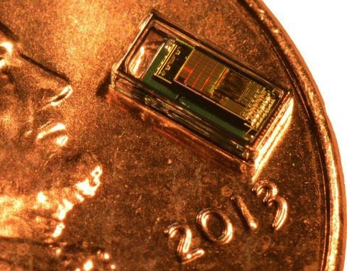
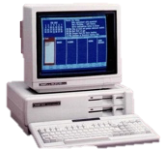

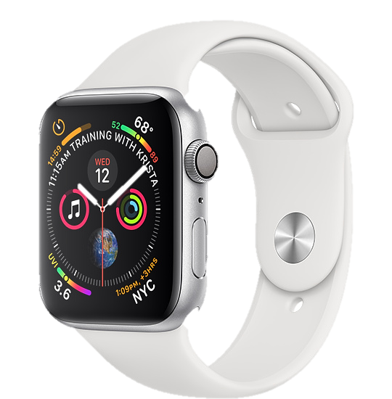
Trillion embedded devices will be deployed soon
Mainframe
“Roughly every decade a new, lower priced computer class forms based on a new programming platform, network, and interface resulting in new usage and the establishment of a new industry.”
1 per Enterprise
Workstation
1 per Engineer
[Bell et al. Computer, 1972, ACM, 2008]
Smart Dust
Laptop
100 – 1000’s per person
log (people per computer)
1 per Professional
IoT/Wearable
Mini Computer
10’s per person
1 per Company
Personal Computer
1 per Family
Smartphone
1 per person

Slide 6
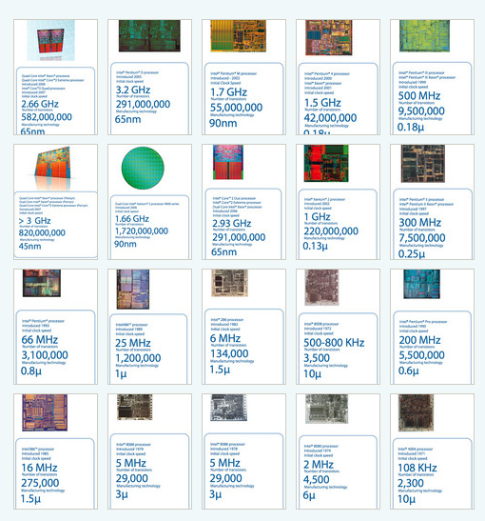
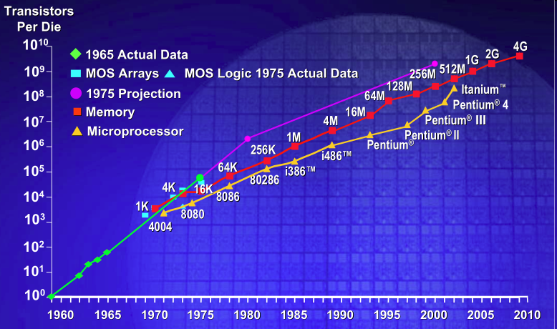
IC transistor count doubles every two years
Photo Credit: Intel
Notes:
So if we look at the computing spectrum today, each of the classes exist simultaneously. In a room we can put 100s of teraflops and many petabytes of computing.
Our productivity, document preparation, and personal information management fits in our pocket and a new class is emerging that will provide a means of streaming information to and from the physical world like we have never seen before.

Slide 7
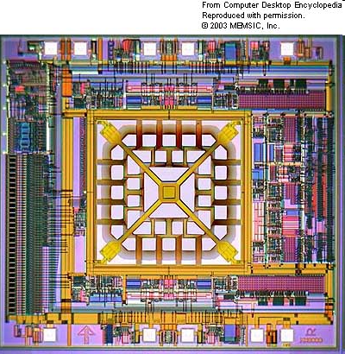
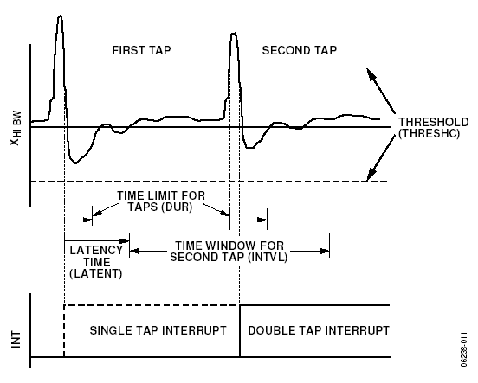
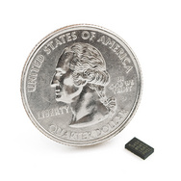
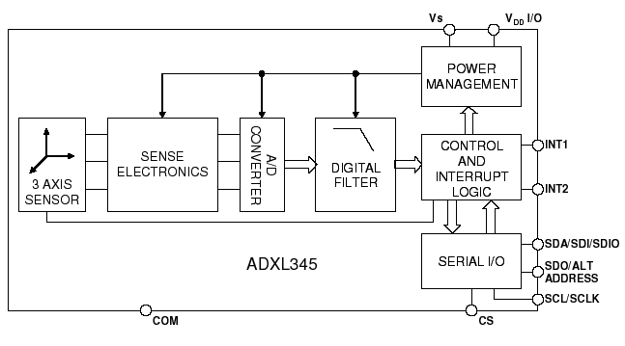
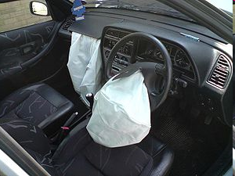
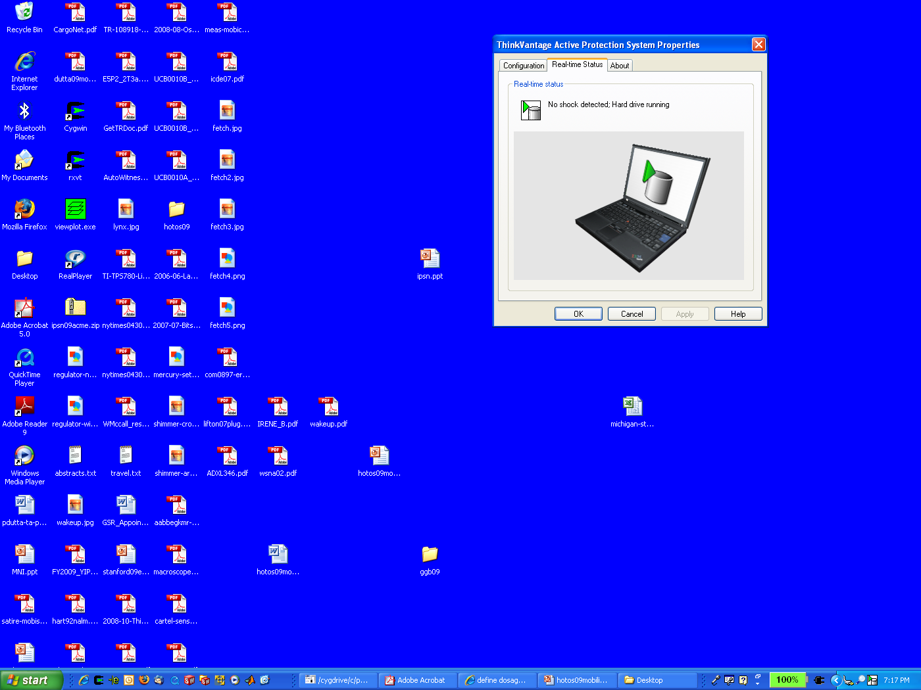
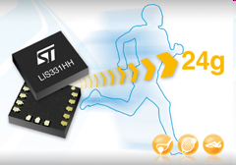
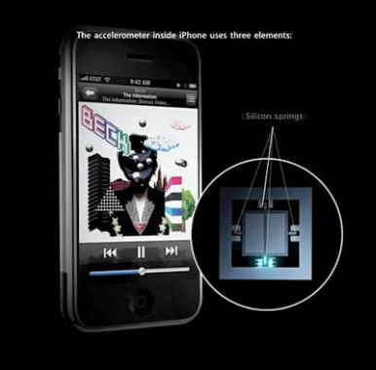
MEMS Accelerometers: Rapidly falling price and power
O(mA)
Price
Power
25 µA @ 25 Hz
ADXL345
[Analog Devices, 2009]
10 µA @ 10 Hz @ 6 bits
[ST Microelectronics, annc. 2009]

Slide 8
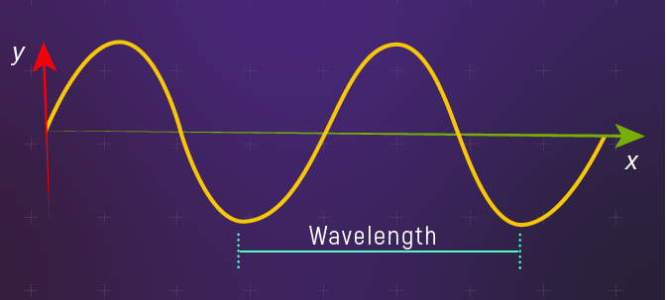
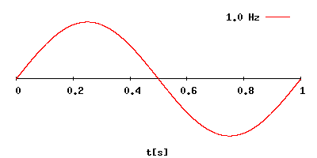
Fundamentals of electromagnetic waves
Electromagnetic (EM) waves are synchronized oscillations of electric and magnetic field. There is a periodic change of electric and magnetic field
How often this periodic change occurs dictates the property of EM waves
Changer period is termed as the frequency. The SI unit for frequency is Hertz (Hz)
1 Hz: one cycle of an electromagnetic wave in a second
Notes:
First, we look at the computational elements, and these consist of a microcontroller or an FPGA. Today, we find that these computational elements consume at least one order of magnitude higher power consumption when compared to the commonly used sensors.
However, we also find that microcontrollers are increasingly becoming energy efficient. We investigate a typical microcontroller that has been used in sensor platforms over the past two decades. We find that energy efficiency has improved by almost two orders of magnitude. Some of the present-generation microcontrollers, such as Ambiq Apollo4 consume just 3 uA/MHz than 330 uA for MSP430 used on platforms such as TelOS B.
If the trend continues, we can expect the microcontrollers to catch up with the sensors and become energy-efficient. This significant improvement is that the digital components are increasing becoming efficient as they follow moore’s law.

Slide 9
What are radio transceivers?
Radio transceivers are components that enables the transmission and reception of electromagnetic waves. A key component in wireless device
Antenna
Radio frequency signal
Transmitting
Device
Receiving Device
Notes:
First, we look at the computational elements, and these consist of a microcontroller or an FPGA. Today, we find that these computational elements consume at least one order of magnitude higher power consumption when compared to the commonly used sensors.
However, we also find that microcontrollers are increasingly becoming energy efficient. We investigate a typical microcontroller that has been used in sensor platforms over the past two decades. We find that energy efficiency has improved by almost two orders of magnitude. Some of the present-generation microcontrollers, such as Ambiq Apollo4 consume just 3 uA/MHz than 330 uA for MSP430 used on platforms such as TelOS B.
If the trend continues, we can expect the microcontrollers to catch up with the sensors and become energy-efficient. This significant improvement is that the digital components are increasing becoming efficient as they follow moore’s law.

Slide 10
How are radio waves characterized?
Radio waves can be characterized based on following parameters:
Strength/Power: energy contained in the radio wave
Frequency: rate of periodic variation between electric and magnetic field
Bandwidth: range of frequencies of radio waves present in the transmission
Polarization: orientation of electric field. May be circular, elliptical or linear
Modulation: variation of waves property to encode information
Notes:
First, we look at the computational elements, and these consist of a microcontroller or an FPGA. Today, we find that these computational elements consume at least one order of magnitude higher power consumption when compared to the commonly used sensors.
However, we also find that microcontrollers are increasingly becoming energy efficient. We investigate a typical microcontroller that has been used in sensor platforms over the past two decades. We find that energy efficiency has improved by almost two orders of magnitude. Some of the present-generation microcontrollers, such as Ambiq Apollo4 consume just 3 uA/MHz than 330 uA for MSP430 used on platforms such as TelOS B.
If the trend continues, we can expect the microcontrollers to catch up with the sensors and become energy-efficient. This significant improvement is that the digital components are increasing becoming efficient as they follow moore’s law.

Slide 11
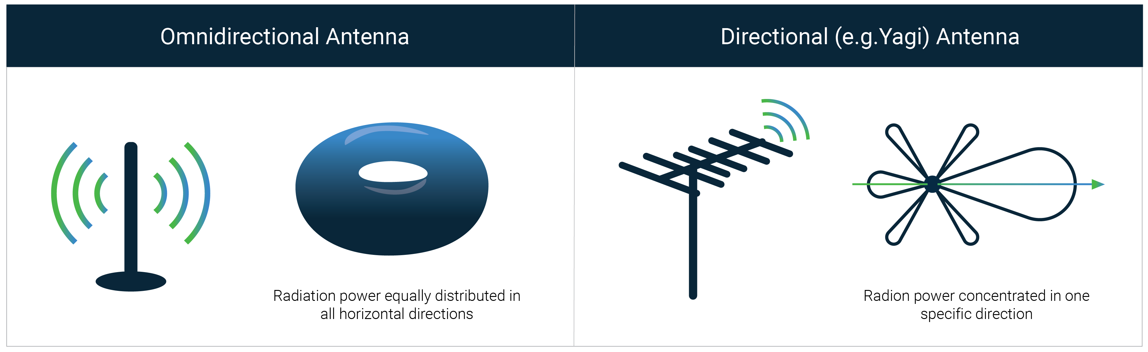
How radio waves radiate out from transceiver
Antenna: An electrical conductor or system of conductors
Transmission: radio frequency electrical energy converted into electromagnetic energy
Reception: the reverse occurs, electromagnetic energy converted into electrical energy
Antennas can be categorized intro directional or omnidirectional
Based on the radiation pattern of the antenna

Slide 12
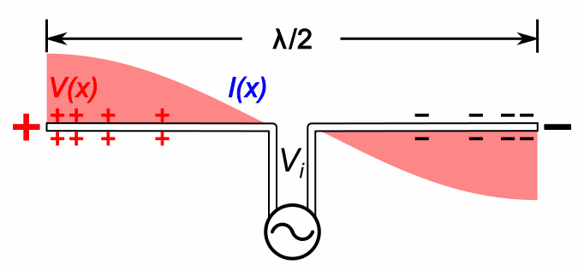
Relationship between antenna size and frequency
Antenna size is inversely proportional to the frequency of radio wave
Higher the frequency, smaller the antenna size
Lower frequency, larger is the antenna size
For example:
Dipole: Length of the conductor is half of the wave length of radio wave
Half-wave dipole: Length of conductor is quarter wavelength of radio wave

Slide 13
Understanding the performance of an antenna
Power output, in a particular direction, compared to that produced in any direction by a perfect omni-directional antenna (isotropic antenna)‏
Effective area: related to physical size and shape of antenna
Relationship between antenna gain and effective area
G = antenna gain
A_{e} = effective area
f = carrier frequency
c = speed of light 3 X 10⁸ m/s
Lambda = carrier wavelength

Slide 14
Roadmap of the lecture today
Quick Recap
Antenna Continued
Line of Sight and Non Line of Sight
Modulation Basics

Slide 15
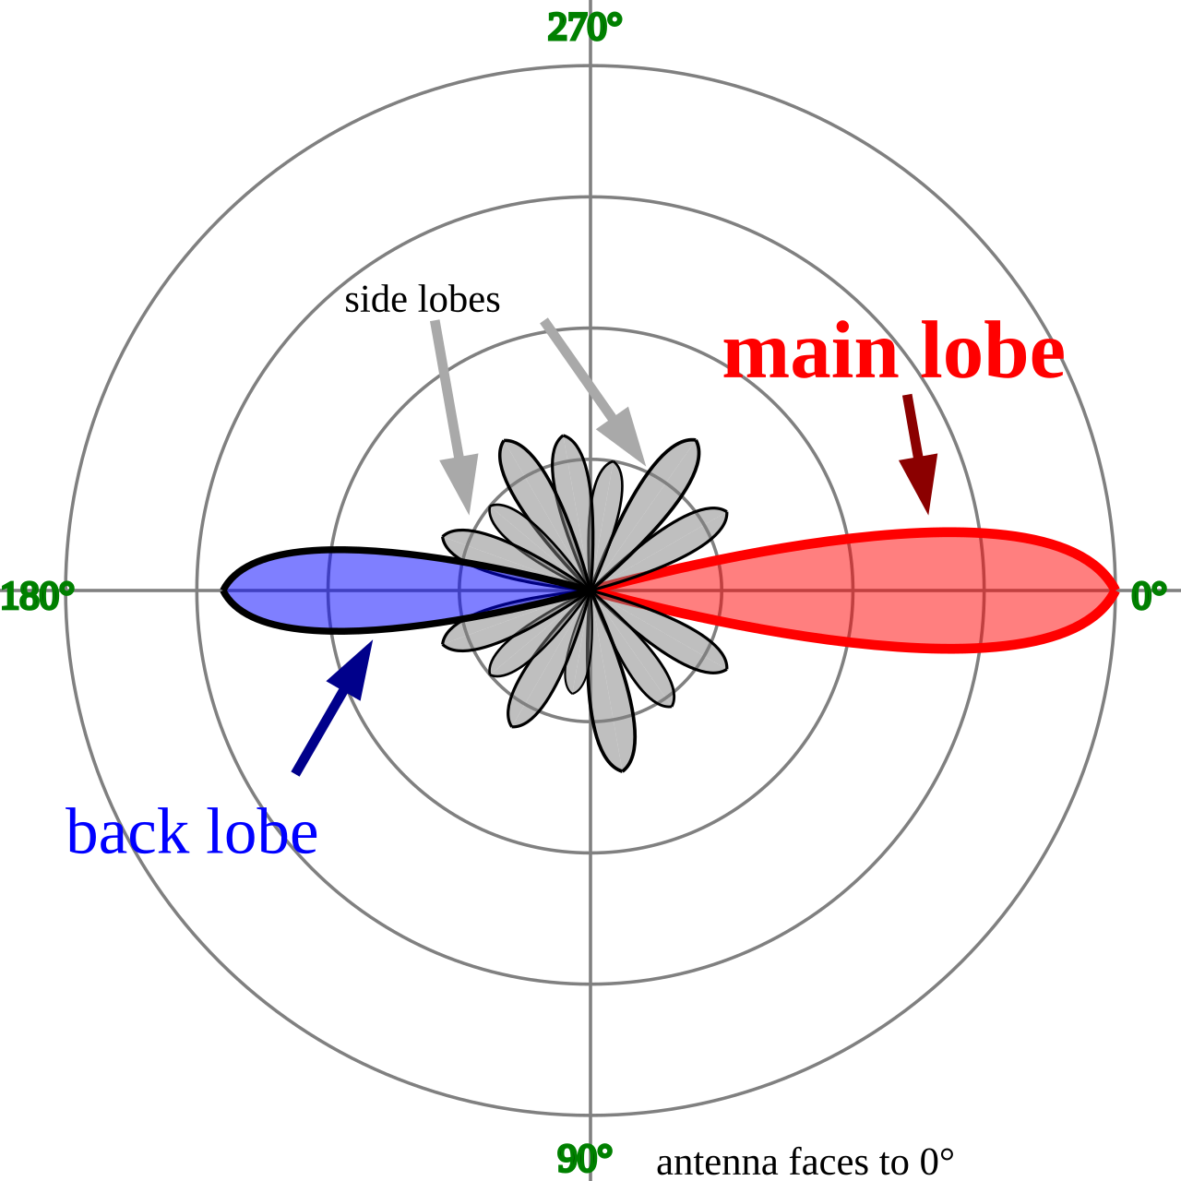
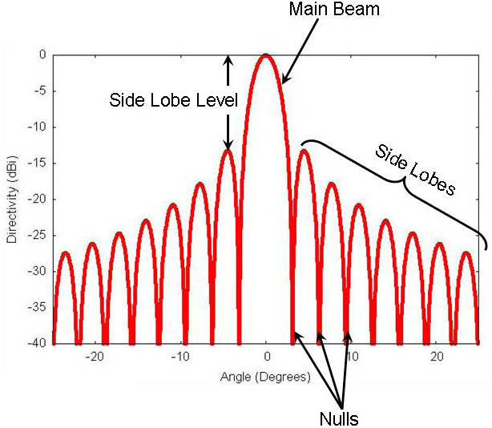
Radiation pattern of the antenna
Radiation pattern of an antenna is a graphical representation of the relative strength of the radiated power in various directions. It illustrates how an antenna distributes energy in space
The radiation pattern is represented as a polar or rectangular plot
Helps you understand the nature of antenna: isotropic, directional or omnidirectional. Helps optimize the placement of wireless devices
Polar Radiation Plot
Rectangular Radiation Plot

Slide 16
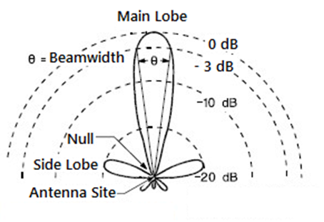
Understanding the antenna beamwidth
Antenna beamwidth is the angular separation between the points on the radiation pattern where the power drops to half of its maximum value, commonly known as the -3 dB points. It defines the directivity and coverage area of the antenna.
Courtesy: EverythingRF

Slide 17
Understanding the antenna beamwidth
Main lobe of radiation pattern is where maximum radiation occurs
Antenna beamwidth is the angular separation between the points on the radiation pattern where the power drops to half of its maximum value, commonly known as the -3 dB points
Beamwidth defines the directivity and coverage area of the antenna.
Courtesy: EverythingRF

Slide 18
Beamwidth and antenna gain
What are the implications of the narrow beamwidth?

Slide 19
Beamwidth and antenna gain
What are the implications of the narrow beamwidth?
Higher directivity
Longer range
Gain?

Slide 20
Beamwidth and antenna gain
What are the implications of the narrow beamwidth?
Higher directivity
Longer range
Gain? Results in longer range
Suitable for point-to-point links
What are the implications of the broader beamwidth?

Slide 21
Beamwidth and antenna gain
What are the implications of the narrow beamwidth?
Higher directivity
Longer range
Gain? Results in longer range
Suitable for point-to-point links
What are the implications of the broader beamwidth?
Covers larger area, smaller directivity
Smaller range
Gain? Lesser gain
Suitable for broadcast applications

Slide 22
Beamwidth and antenna gain
What are the implications of the narrow beamwidth?
Higher directivity
Longer range
Gain? Results in longer range
Suitable for point-to-point links
What are the implications of the broader beamwidth?
Covers larger area, smaller directivity
Smaller range
Gain? Lesser gain
Suitable for broadcast applications

Slide 23
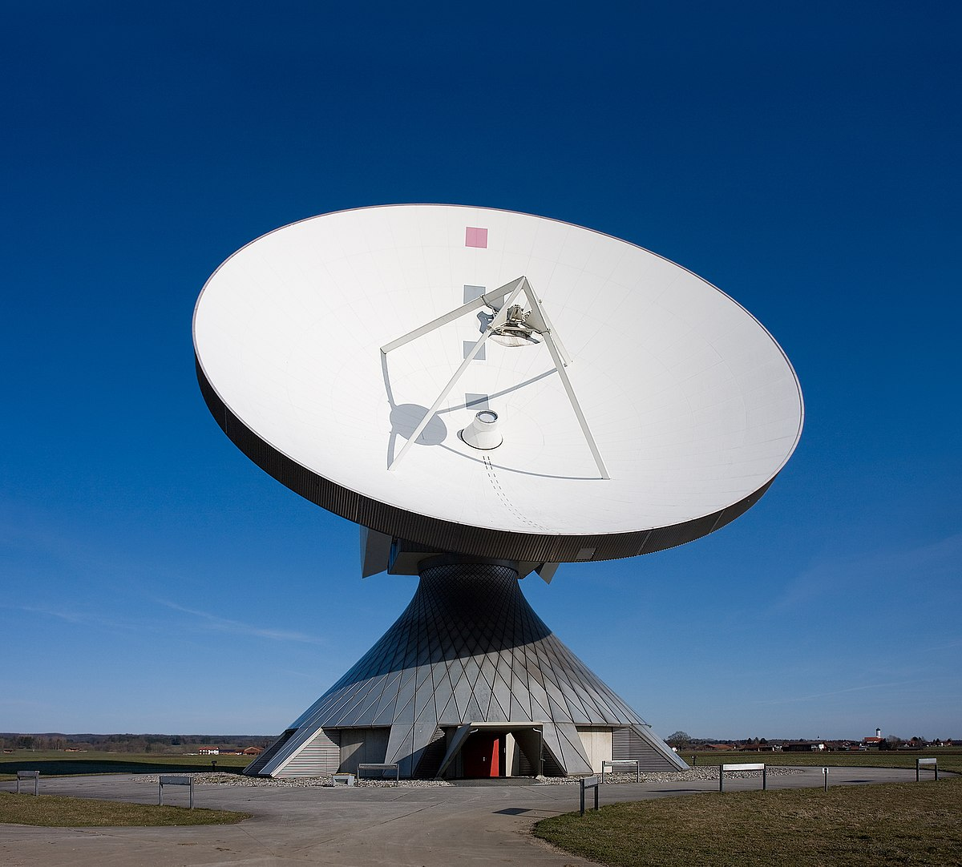
Beamwidth and antenna gain
Parabolic Antenna. Highly Directional.

Slide 24
Beamwidth and antenna gain
Parabolic Antenna. Highly Directional.
Beamwidth: 0 – 10 degrees

Slide 25
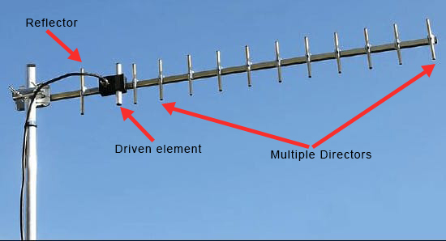
Beamwidth and antenna gain
Yagi-uda. Directional Antenna.

Slide 26
Beamwidth and antenna gain
Yagi-uda. Directional Antenna.
Beamwidth: 15 to 40 degrees

Slide 27
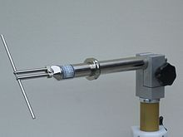
Beamwidth and antenna gain
Dipole Antenna. Somewhat omnidrectional

Slide 28
Beamwidth and antenna gain
Dipole Antenna. Somewhat omnidrectional
Beamwidth: 70 to 120 degrees

Slide 29
Wireless Signal Propagation, Modulation, Estimating Range
Notes:
++ Over the past few years, I have designed several backscatter and beyond backscatter systems that precisely overcome these critical challenges that have limited the widespread deployment of backscatter on IoT devices.
++ The research vision that I have pursued and would like to pursue as a faculty member is to enable a massive deployment of IoT devices by bridging the energy asymmetry between sensing, computation and communication blocks by designing novel platforms and communication mechanisms. I am going to describe some of my research contributions next.

Slide 30
How radio waves propagate to the receiver
Antenna
Radio frequency signal
Transmitting
Device
Receiving Device

Slide 31
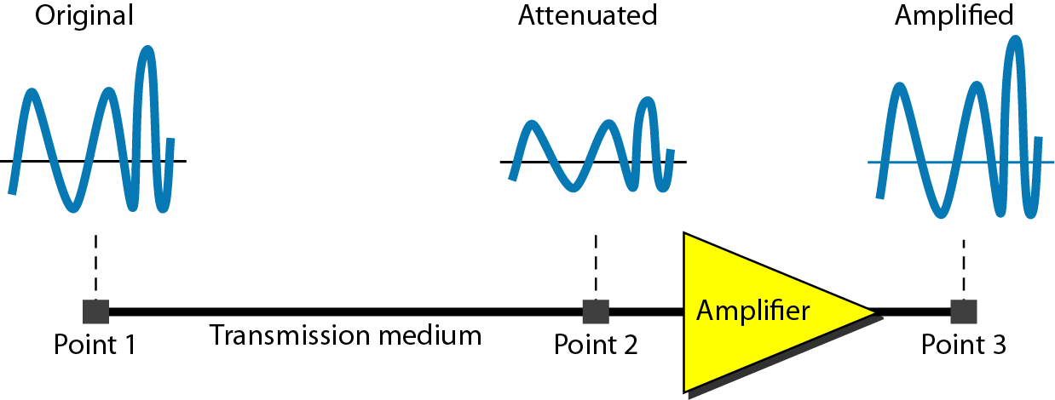
Attenuation and Gain: Decibel (dB) unit
Attenuation: Means loss of energy
When signal traverses through a medium, it loses energy.
Gain: Means increase in energy
Often devices such as amplifiers are employed to improve the signal strength
Commonly, we use decibel to calculate gain or loss/attenuation of signal
dB = 10log₁₀P₂/P₁
P₁ - input signal, P₂ - output signal

Slide 32
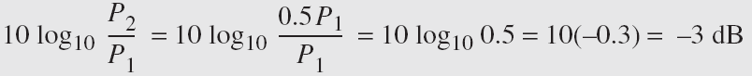
Operations in decibel (dB) examples
Suppose a signal travels through a transmission medium and its power decreases to one-half of its original value, meaning that P2 is equal to (1/2)P1. In this scenario, the attenuation, or loss of power, can be determined using the following formula:
Thus, loss of 3 dB, is equivalent to losing half of the signal power

Slide 33
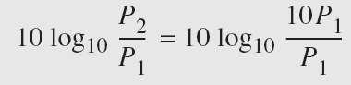
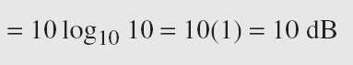
Operations in decibel (dB) examples
A signal passes through an amplifier, resulting in a tenfold increase in power, expressed as P2 = 10P1. The amplification, also known as the power gain, can be calculated as:
One reason engineers use decibels to measure changes in signal strength is that decibel values can be easily added or subtracted
L1 = 3 dB, L2 = 7 db, Combined loss: 10 dB

Slide 34
Some common numbers
What does a 10 dB increase in signal represent?

Slide 35
Some common numbers
What does a 10 dB increase in signal represent?
10X increase in the signal power
What does a 20 dB increase in signal represent?

Slide 36
Some common numbers
What does a 10 dB increase in signal represent?
10X increase in the signal power
What does a 20 dB increase in signal represent?
100X increase in signal power

Slide 37
Some common numbers
What does a 10 dB increase in signal represent?
10X increase in the signal power
What does a 20 dB increase in signal represent?
100X increase in signal power
What does a 30 dB increase in signal represent?

Slide 38
Some common numbers
What does a 10 dB increase in signal represent?
10X increase in the signal power
What does a 20 dB increase in signal represent?
100X increase in signal power
What does a 30 dB increase in signal represent?
1000X increase in signal power

Slide 39
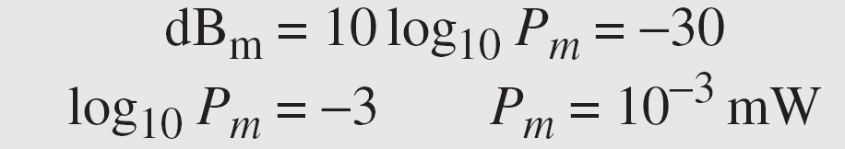
Unit of power of a signal: dBm (decibel milliwatt)
Decibel (dBm) is a measure of signal power, calculated as 10 log10 (Pm) where Pm is power in milliwatts
Example: Calculate the power of a signal with dB_{m} = −30

Slide 40
Some useful values to remember
3 dB reduction corresponds to a loss of half of the power. 3 dB decrease results in a power that is 50% lower than the original value
0 dBm represents a transmit power of 1 milliwatt (mW). This is commonly used as a reference point in communication systems
30 dBm, which corresponds to a transmit power of 1 watt (W). It is often the maximum permissible output power for devices operating in unlicensed frequency bands, such as those used in Wi-Fi and other wireless communication technologies.

Slide 41
Roadmap of the lecture today
Quick Recap
Antenna Continued
Line of Sight and Non Line of Sight
Modulation Basics

Slide 42


How do radio waves propagate from TX to RX?
Medium and environment has an important role to play in propagation
Radio waves do not propagate well underwater. Submarines uses sound
Environment impacts the radio wave propagation significantly
Reduced communication range
Interference from other devices
Issues with reliability
…… and many more

Slide 43
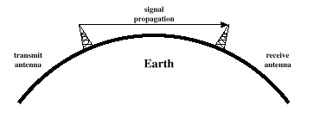
Radio waves propagation in line-of-sight
Transmitting and receiving antennas must be within line of sight
Satellite communication – signal above 30 MHz not reflected by ionosphere
Ground communication – antennas in effective line of site due to refraction

Slide 44
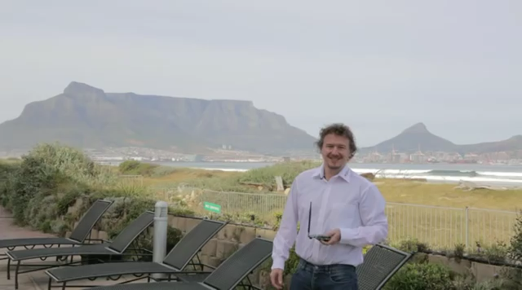
Long range wireless transmissions using IoT devices

Slide 45
Estimating received signal strength and range: Friis propagation model
f_{c} is the center frequency in Hz
c is speed of light
d is the distance between transmitter and receiver
Alpha is the path loss component
G is antenna gain

Slide 46
Path Loss Exponent
Environment
Path Loss Exponential (α)
Free Space
2
Urban area cellualr radio
2.7 to 3.5
Shadowed urban cellular radio
3 to 5
In building LOS
1.6 to 1.8
Obstructed in building
4 to 6
Obstructed in factory
2 to 3
Rapport, Table 4.2, pp139

Slide 47
Radio propagation is complex in real-world, especially when obstacles are present

Slide 48


Non-line of sight propagation of radio waves
Transmitter and receiver are not kept in line of sight
Radio waves encounter obstacles, may go through walls, buildings
Much more applicable to read world environment and deployments
Significantly impacts the communication range and reliability

Slide 49
Example: Range and antenna gain estimation
Question: A wireless receiver with an effective radius of 100cm is receiving signals at 2 GHz from a transmitter that transmits at a power of 100W and a gain of 40dB (or 10,000). Assume path loss exponent is 2.
What is the gain of the receiver antenna?
What is the received power if the receiver is 1km away from the transmitter?
If the receiver is receiving signals at 900 MHz frequency (instead of 2GHz), please calculate (a) and (b) again?
What do you notice and why?

Slide 50
Total link gain in wireless communication
Total link gain represents the net amplification and attenuation of the electromagnetic signal along the communication path
What are the factors that are included in the total link gain?

Slide 51

Total link gain in wireless communication
Total link gain represents the net amplification and attenuation of the electromagnetic signal along the communication path
What are the factors that are included in the total link gain?
Antennas
Free space path loss
And other system component
G_{tx} = Transmitter antenna gain (dB)
G_{rx}= Receiver antenna gain (dB)
L_{Path} = Path loss (dB), including free-space loss
L_{Misc}= Miscellaneous losses (dB), such as atmospheric losses, cable losses, and interference effects

Slide 52
Let us look at another example
Question: Two office buildings 1 km apart are connected via a point-to-point microwave link operating at 5 GHz. High-gain directional antennas of similar type are used on both sides to ensure minimal signal loss.
If each of the antenna has an effective area of 0.05 m²
What is the total link gain?

Slide 53
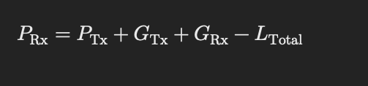
Link Budget and Total Link Gain
Calculation that takes into account all gains and losses to determine received signal strength of wireless signal in a communication system
Total Link Budget (P_{rx}) = P_{tx} + Total Link Gain

Slide 54
Previous year’s assessment question
Question: Over the past several years, we have seen a growing interest in utilizing satellites to provide wireless connectivity to Internet of Things (IoT) devices. These satellites usually operate at altitudes of 400 to 500 kilometers from the Earth's surface. However, this deployment of satellites has led to concerns regarding orbital congestion and pollution. As an alternative, high-altitude balloons are being explored to provide network connectivity to Internet of things devices. These balloons fly at much lower altitudes of around 20 kilometers from earth’s surface and they offer a very cost-effective solution to satellite launches.

Slide 55
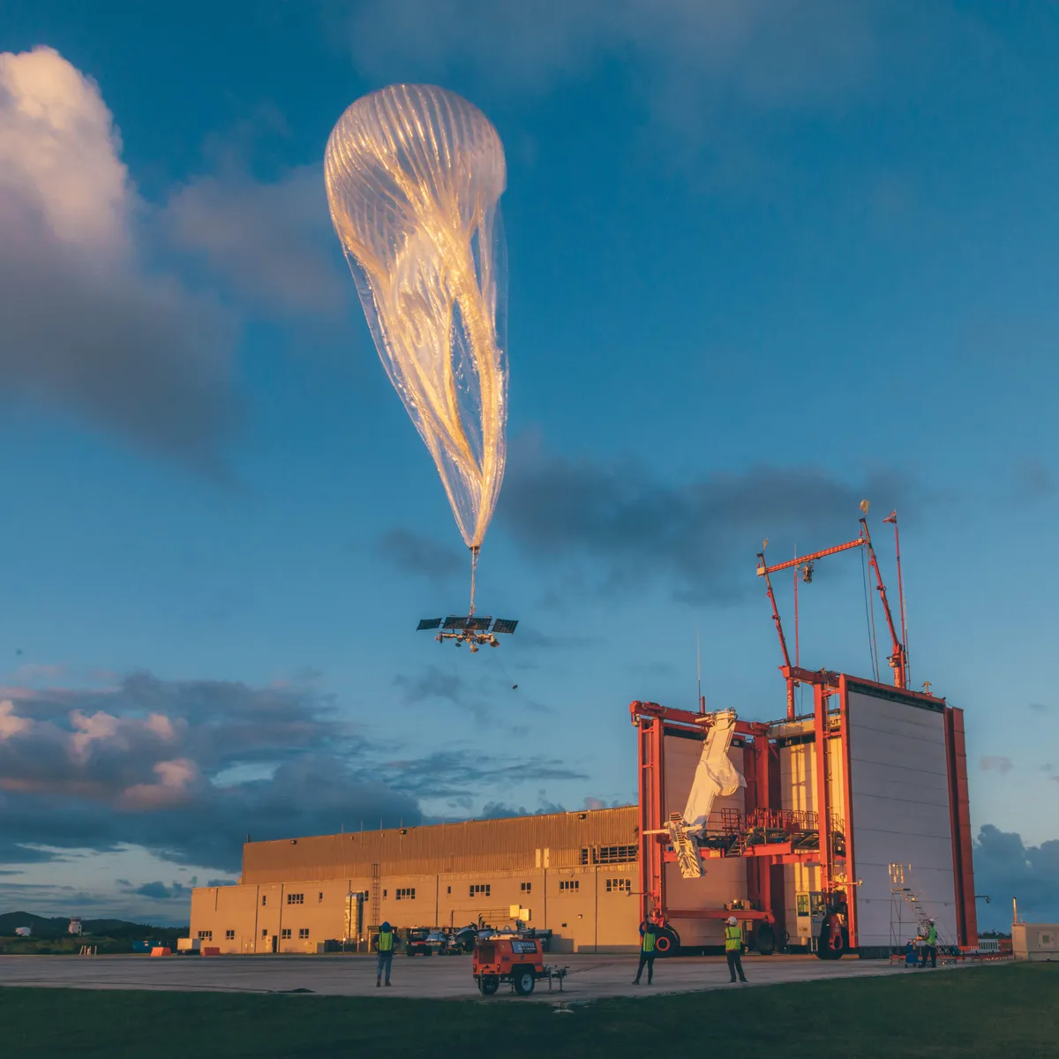
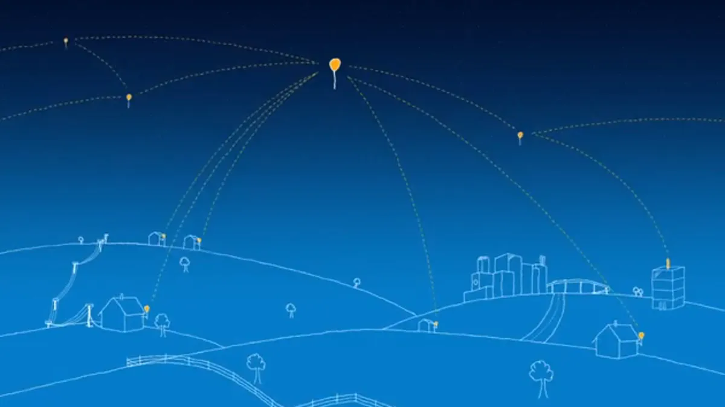
Google Project Loon? Do you know?
Google Project Loon: https://x.company/projects/loon/

Slide 56
One of the last year’s question
If you are using low-altitude balloons to provide connectivity to ground based IoT devices. Please answer the following questions:
What type of antennas are suitable for use on the high-altitude balloons and ground based IoT devices to ensure reliable communication?
Provide appropriate rationale for your choice

Slide 57
One of the last year’s question
If you are using low-altitude balloons to provide connectivity to ground based IoT devices. Please answer the following questions:
What type of antennas are suitable for use on the high-altitude balloons and ground based IoT devices to ensure reliable communication?
Provide appropriate rationale for your choice
ANSWER:
Balloon - We can use directional antenna such as parabolic antenna to ensure the energy is directed towards the deployment of IoT device.
On IoT devices - Omnidirectional antennas, as it can allow them to receive energy from any direction even if these devices are mobile. It would allow us to avoid positioning the nodes with limited line-of-sight to the balloon.

Slide 58
One of the last year’s question
(b) Which frequency bands are suitable for communication between balloon and IoT device? Provide appropriate rationale for your choice. (1 point)

Slide 59
One of the last year’s question
(b) Which frequency bands are suitable for communication between balloon and IoT device? Provide appropriate rationale for your choice. (1 point)
ANSWER:
Sub-GHz bands due to their superior propagation characteristics. Ideally, we should be looking at ISM frequency bands.
For some application, perhaps, 2.4 GHz may work.

Slide 60
One of the last year’s question
(c) From a wireless communication perspective, what are two advantages and disadvantages of using balloons for connectivity in IoT devices compared to satellite-based solutions? (2 point)

Slide 61
One of the last year’s question
(c) From a wireless communication perspective, what are two advantages and disadvantages of using balloons for connectivity in IoT devices compared to satellite-based solutions? (2 point)
ANSWER:
There can be several advantages:
1. Lower latency owing to lower altitude of the balloon
2. We can use ISM frequency bands due to shorter distances for communication
3. Better signal quality owing to stronger signals
Cons:
1. Limited coverage when compared to satellites, may require several balloons overhead
2. Greater chance of interference with terrestrial and other such transmissions
3. Higher maintenance overhead to replace and maintain balloons

Slide 62
One of the last year’s question
(d) Given that the IoT device is equipped with a radio with a receive sensitivity of -100 dBm and an antenna gain of 2 dB. There is an estimated distance of 20 kilometers between the balloon and the IoT device, and the balloon is equipped with 8 dB antenna. Please calculate the transmit power required at the balloon to ensure successful packet reception at IoT device. Use the frequency selected in part (b) for your calculations. The path loss exponent is 2. (4 point)

Slide 63
Roadmap of the lecture today
Quick Recap
Antenna Continued
Line of Sight and Non Line of Sight
Modulation Basics

Slide 64
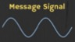
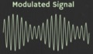

How are radio waves modified to carry information
Encoding information “baseband" in an analog “carrier” signal
Baseband signal often much lower in frequency than the carrier
Frequency of the carrier signal dictates the part of the radio spectrum
Why? baseband signals or information change is at much lower rate
Speech: upto 20 KHz, temperature changes – few Hz
Enables a better usage of the radio spectrum
Enables communication among several devices sharing the spectrum
Modulation
Notes:
First, we look at the computational elements, and these consist of a microcontroller or an FPGA. Today, we find that these computational elements consume at least one order of magnitude higher power consumption when compared to the commonly used sensors.
However, we also find that microcontrollers are increasingly becoming energy efficient. We investigate a typical microcontroller that has been used in sensor platforms over the past two decades. We find that energy efficiency has improved by almost two orders of magnitude. Some of the present-generation microcontrollers, such as Ambiq Apollo4 consume just 3 uA/MHz than 330 uA for MSP430 used on platforms such as TelOS B.
If the trend continues, we can expect the microcontrollers to catch up with the sensors and become energy-efficient. This significant improvement is that the digital components are increasing becoming efficient as they follow moore’s law.

Slide 65
What are different modulation techniques?
Vary frequency, amplitude, phase of carrier signal according message signal
We can also vary them together to support complex modulation schemes
Analog and Digital counterparts of these modulation schemes exist
Modulation
Notes:
First, we look at the computational elements, and these consist of a microcontroller or an FPGA. Today, we find that these computational elements consume at least one order of magnitude higher power consumption when compared to the commonly used sensors.
However, we also find that microcontrollers are increasingly becoming energy efficient. We investigate a typical microcontroller that has been used in sensor platforms over the past two decades. We find that energy efficiency has improved by almost two orders of magnitude. Some of the present-generation microcontrollers, such as Ambiq Apollo4 consume just 3 uA/MHz than 330 uA for MSP430 used on platforms such as TelOS B.
If the trend continues, we can expect the microcontrollers to catch up with the sensors and become energy-efficient. This significant improvement is that the digital components are increasing becoming efficient as they follow moore’s law.

Slide 66
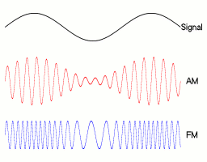
Amplitude modulation: vary amplitude of carrier signal
Change amplitude of a carrier signal according to the message signal
Simplest and the earliest modulation technique
Remains widely used for radio broadcast, also computer communication
Notes:
First, we look at the computational elements, and these consist of a microcontroller or an FPGA. Today, we find that these computational elements consume at least one order of magnitude higher power consumption when compared to the commonly used sensors.
However, we also find that microcontrollers are increasingly becoming energy efficient. We investigate a typical microcontroller that has been used in sensor platforms over the past two decades. We find that energy efficiency has improved by almost two orders of magnitude. Some of the present-generation microcontrollers, such as Ambiq Apollo4 consume just 3 uA/MHz than 330 uA for MSP430 used on platforms such as TelOS B.
If the trend continues, we can expect the microcontrollers to catch up with the sensors and become energy-efficient. This significant improvement is that the digital components are increasing becoming efficient as they follow moore’s law.

Slide 67

Amplitude modulation: vary amplitude of carrier signal
A_{c} = Carrier amplitude
A_{m} = Modulating (baseband) signal amplitude
m(t) = Message signal
f_{c} = Carrier frequency

Slide 68
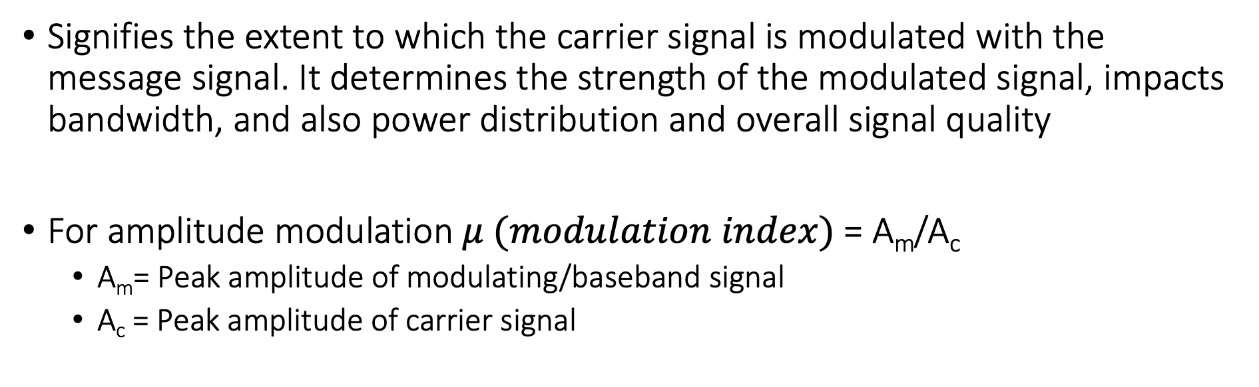
Modulation Index
Signifies the extent to which the carrier signal is modulated with the message signal. It determines the strength of the modulated signal, impacts bandwidth, and also power distribution and overall signal quality
For amplitude modulation $μ (modulation index)$= A_{m}/A_{c}
A_{m}= Peak amplitude of modulating/baseband signal
A_{c} = Peak amplitude of carrier signal

Slide 69
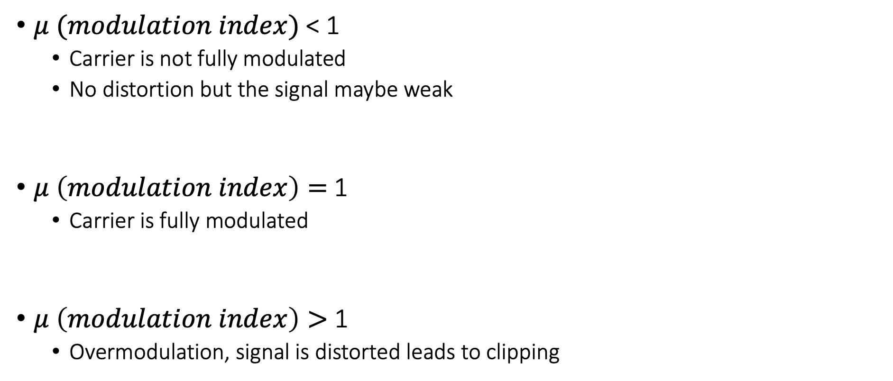

Significance of modulation index ($μ$)
$μ (modulation index)$< 1
Carrier is not fully modulated
No distortion but the signal maybe weak
$μ \left(modulation index\right)=$1
Carrier is fully modulated
$μ \left(modulation index\right)>$ 1
Overmodulation, signal is distorted leads to clipping

Slide 70
Amplitude modulation example
You are given a carrier signal with the frequency of 100 KHz and amplitude of 5. It is modulated using amplitude modulation (double side band, full carrier) with a message/baseband signal of the frequency 5 KHz and amplitude 2.
Please determine modulation index and mathematical expression representing the modulated signal?

Slide 71
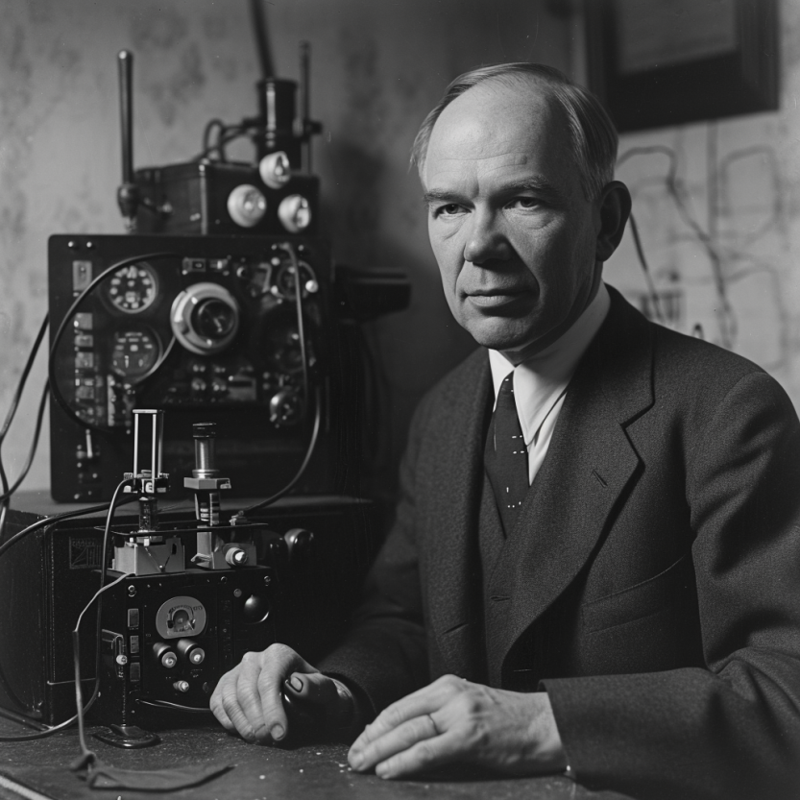
Frequency modulation: vary frequency of carrier signal
Change frequency of a carrier signal according to the message signal
Advantages (over AM): Resilient to interference, spectrum efficiency
Remains widely used for radio broadcast, also computer communication
First demonstrated by Armstrong in 1935!
Notes:
First, we look at the computational elements, and these consist of a microcontroller or an FPGA. Today, we find that these computational elements consume at least one order of magnitude higher power consumption when compared to the commonly used sensors.
However, we also find that microcontrollers are increasingly becoming energy efficient. We investigate a typical microcontroller that has been used in sensor platforms over the past two decades. We find that energy efficiency has improved by almost two orders of magnitude. Some of the present-generation microcontrollers, such as Ambiq Apollo4 consume just 3 uA/MHz than 330 uA for MSP430 used on platforms such as TelOS B.
If the trend continues, we can expect the microcontrollers to catch up with the sensors and become energy-efficient. This significant improvement is that the digital components are increasing becoming efficient as they follow moore’s law.

Slide 72
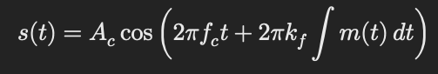
Frequency modulation: vary frequency of carrier signal
A_{c} = Carrier amplitude
f_{c} = Carrier frequency
k_{f} = Frequency sensitivity of the modulator (how much the carrier frequency changes in response to the amplitude of the modulating signal)
m(t) = Modulating signal
Notes:
First, we look at the computational elements, and these consist of a microcontroller or an FPGA. Today, we find that these computational elements consume at least one order of magnitude higher power consumption when compared to the commonly used sensors.
However, we also find that microcontrollers are increasingly becoming energy efficient. We investigate a typical microcontroller that has been used in sensor platforms over the past two decades. We find that energy efficiency has improved by almost two orders of magnitude. Some of the present-generation microcontrollers, such as Ambiq Apollo4 consume just 3 uA/MHz than 330 uA for MSP430 used on platforms such as TelOS B.
If the trend continues, we can expect the microcontrollers to catch up with the sensors and become energy-efficient. This significant improvement is that the digital components are increasing becoming efficient as they follow moore’s law.

Slide 73
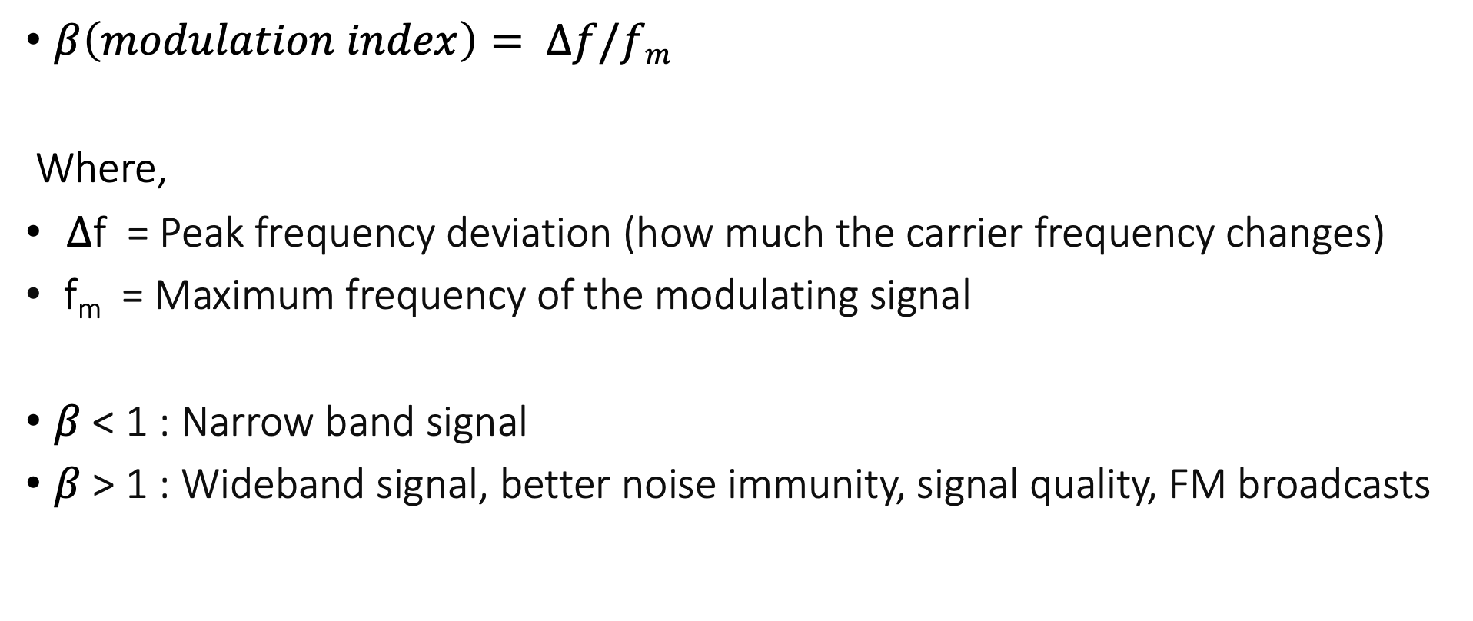
Modulation Index of frequency modulated signal
$β\left(modulation index\right)= ∆f/fm$
Where,
$∆$f = Peak frequency deviation (how much the carrier frequency changes)
f_{m} = Maximum frequency of the modulating signal
$β$ < 1 : Narrow band signal
$β$ > 1 : Wideband signal, better noise immunity, signal quality, FM broadcasts
Notes:
First, we look at the computational elements, and these consist of a microcontroller or an FPGA. Today, we find that these computational elements consume at least one order of magnitude higher power consumption when compared to the commonly used sensors.
However, we also find that microcontrollers are increasingly becoming energy efficient. We investigate a typical microcontroller that has been used in sensor platforms over the past two decades. We find that energy efficiency has improved by almost two orders of magnitude. Some of the present-generation microcontrollers, such as Ambiq Apollo4 consume just 3 uA/MHz than 330 uA for MSP430 used on platforms such as TelOS B.
If the trend continues, we can expect the microcontrollers to catch up with the sensors and become energy-efficient. This significant improvement is that the digital components are increasing becoming efficient as they follow moore’s law.

Slide 74
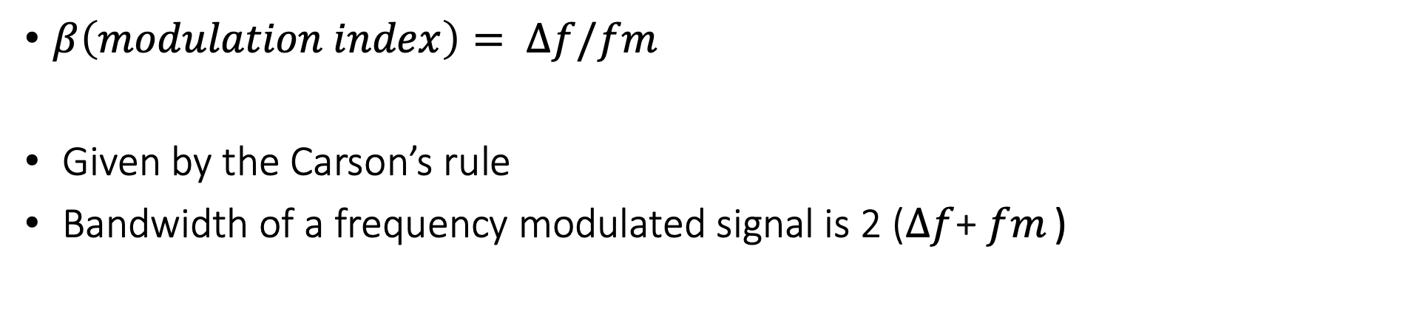
Bandwidth of frequency modulated signals
$β\left(modulation index\right)= ∆f/fm$
Given by the Carson’s rule
Bandwidth of a frequency modulated signal is 2 ($∆f$+ $fm$ )
Notes:
First, we look at the computational elements, and these consist of a microcontroller or an FPGA. Today, we find that these computational elements consume at least one order of magnitude higher power consumption when compared to the commonly used sensors.
However, we also find that microcontrollers are increasingly becoming energy efficient. We investigate a typical microcontroller that has been used in sensor platforms over the past two decades. We find that energy efficiency has improved by almost two orders of magnitude. Some of the present-generation microcontrollers, such as Ambiq Apollo4 consume just 3 uA/MHz than 330 uA for MSP430 used on platforms such as TelOS B.
If the trend continues, we can expect the microcontrollers to catch up with the sensors and become energy-efficient. This significant improvement is that the digital components are increasing becoming efficient as they follow moore’s law.

Slide 75
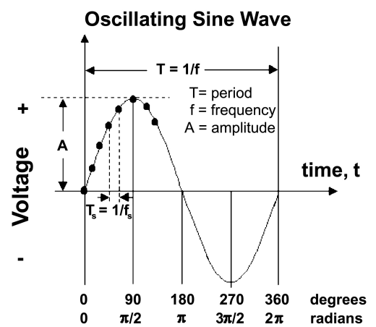
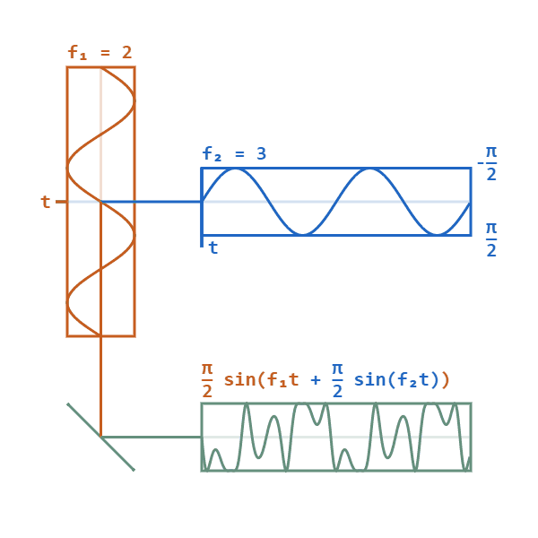
Phase modulation: vary phase of carrier signal
Change phase of a carrier signal according to the message signal
It is an integral part of modern communication standards: WiFi, Television
Advantages (over FM): Better SNR, spectral efficiency
Notes:
First, we look at the computational elements, and these consist of a microcontroller or an FPGA. Today, we find that these computational elements consume at least one order of magnitude higher power consumption when compared to the commonly used sensors.
However, we also find that microcontrollers are increasingly becoming energy efficient. We investigate a typical microcontroller that has been used in sensor platforms over the past two decades. We find that energy efficiency has improved by almost two orders of magnitude. Some of the present-generation microcontrollers, such as Ambiq Apollo4 consume just 3 uA/MHz than 330 uA for MSP430 used on platforms such as TelOS B.
If the trend continues, we can expect the microcontrollers to catch up with the sensors and become energy-efficient. This significant improvement is that the digital components are increasing becoming efficient as they follow moore’s law.

Slide 76
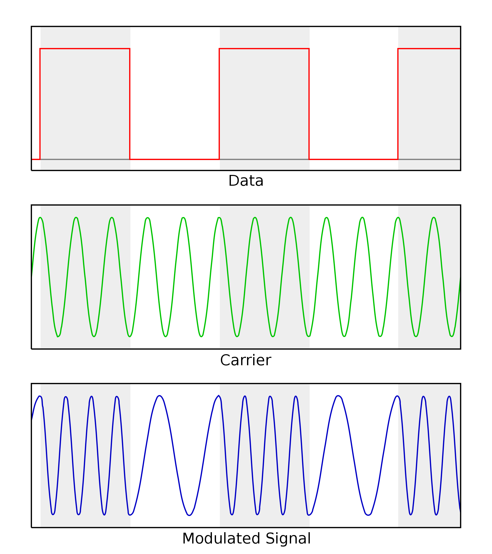
Digital equivalent of the AM, FM and PM modulation
Digital variant of these schemes vary analog signal according to digital bits
ASK: amplitude shift keying
FSK: frequency shift keying
PSK: phase shift keying
Digital variants relevant when we talk about computer communication
Notes:
First, we look at the computational elements, and these consist of a microcontroller or an FPGA. Today, we find that these computational elements consume at least one order of magnitude higher power consumption when compared to the commonly used sensors.
However, we also find that microcontrollers are increasingly becoming energy efficient. We investigate a typical microcontroller that has been used in sensor platforms over the past two decades. We find that energy efficiency has improved by almost two orders of magnitude. Some of the present-generation microcontrollers, such as Ambiq Apollo4 consume just 3 uA/MHz than 330 uA for MSP430 used on platforms such as TelOS B.
If the trend continues, we can expect the microcontrollers to catch up with the sensors and become energy-efficient. This significant improvement is that the digital components are increasing becoming efficient as they follow moore’s law.

Slide 77
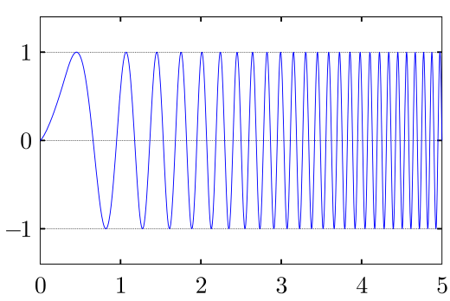
Even more complex modulation schemes exist
Builds on simple modulation schemes AM, FM, PM (or digital equivalent)
Briefly cover some during later part of the course
Complex modulation schemes ensure better performance
Spectral efficiency
Higher range
Higher throughput
……
Choice of the modulation scheme depends on the target application
Notes:
First, we look at the computational elements, and these consist of a microcontroller or an FPGA. Today, we find that these computational elements consume at least one order of magnitude higher power consumption when compared to the commonly used sensors.
However, we also find that microcontrollers are increasingly becoming energy efficient. We investigate a typical microcontroller that has been used in sensor platforms over the past two decades. We find that energy efficiency has improved by almost two orders of magnitude. Some of the present-generation microcontrollers, such as Ambiq Apollo4 consume just 3 uA/MHz than 330 uA for MSP430 used on platforms such as TelOS B.
If the trend continues, we can expect the microcontrollers to catch up with the sensors and become energy-efficient. This significant improvement is that the digital components are increasing becoming efficient as they follow moore’s law.

Slide 78
Roadmap of the lecture today
Quick Recap
Antenna Continued
Line of Sight and Non Line of Sight
Modulation Basics

Slide 79
Wireless Networking
Ambuj Varshney
ambujv@nus.edu.sg
Notes:
++ Thank you for inviting me to give this talk
++ In this talk, I will present a pathway that can enable us to make wireless embedded systems ubiquitous. I will describe my previous research efforts that tackle the critical challenges that limit the growth of wireless embedded systems. These are related to the growing energy asymmetry that exists between sensing, computation and communication blocks on these platforms.
++ Finally, I will conclude my talk by covering the research agenda that I would like to work on as a faculty member.

